Slide 1
Cultural Contexts 1: Migration & Conversion
Prelims Paper 2 (650–1350)
Dr Rachel A. Burns
rachel.burns@ell.ox.ac.uk

Slide 2
CULTURAL CONTEXTS SERIES, WEEKS 1–4
Paper 2: Early Medieval Literature, c. 650 – 1350
(https://oess.web.ox.ac.uk/sitefiles/ell-prelims-handbook-2023-24-v1.0.pdf, pp. 15-16)
Daniel Anlezark, ‘The Anglo-Saxon World View’, The Cambridge Companion to Old English Literature (2013), pp. 66-81
WEEK 1: MIGRATION AND CONVERSION
WEEK 2: INVASION AND KINGSHIP
WEEK 3: RULE AND REFORM
WEEK 4: STRUGGLE AND CONQUEST

Slide 3
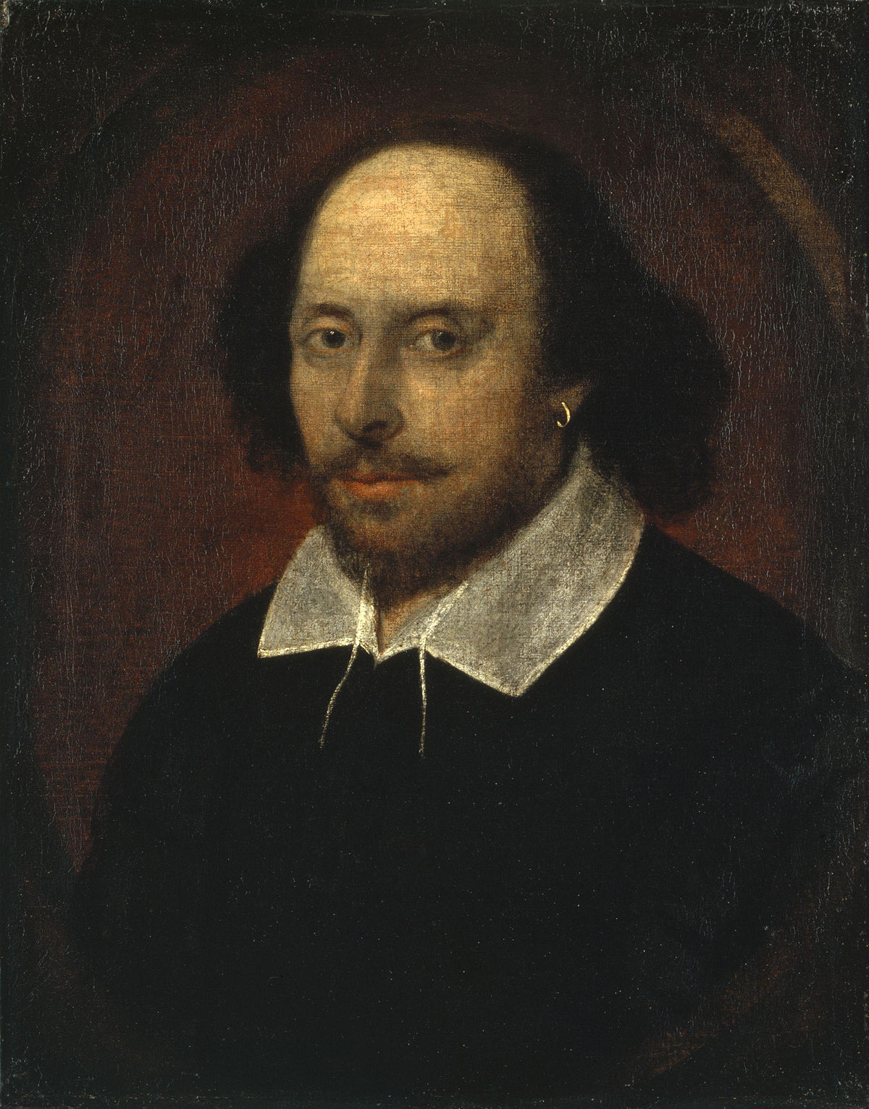

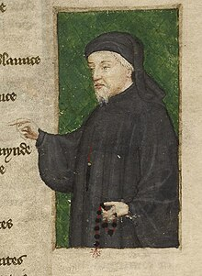

HOW LONG AGO ARE WE TALKING?
Roman Britain
Prelims Paper 2 (650-1350)
650
?
1066
1400
1605
2023
14th century = 1300s
10th century = 900s
Etc!

Slide 4

MEMORIES OF EMPIRE
55 BC – Romans begin the conquest of Britain
c. 410 CE (AD) – Romans withdraw forces from Britain

Slide 5
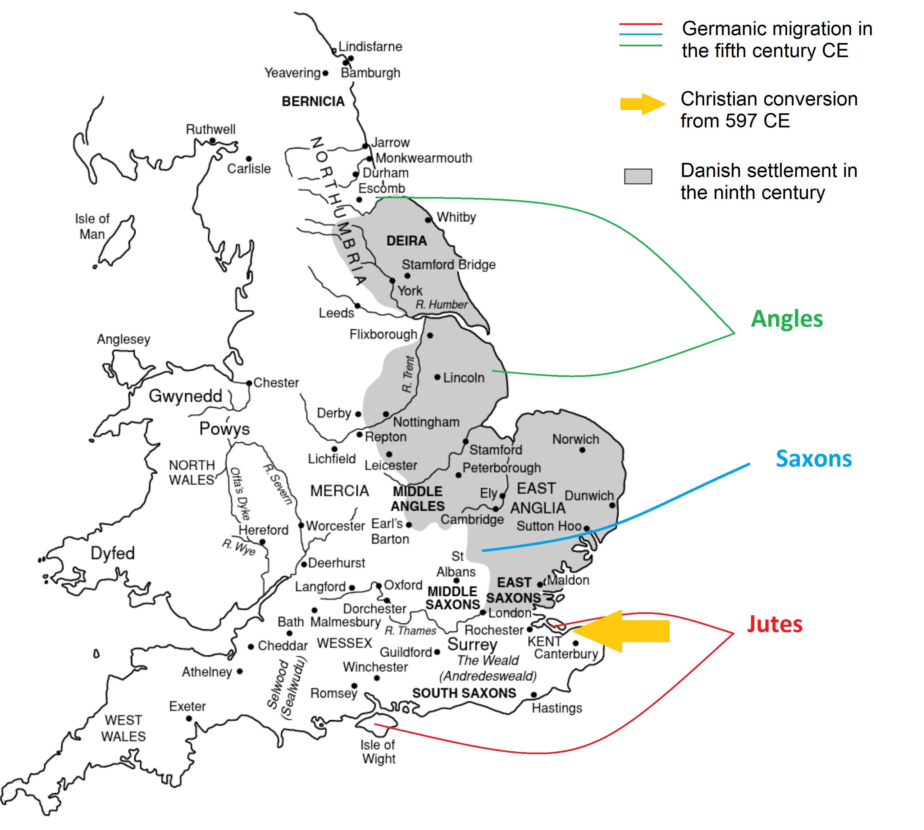
ADVENTUS SAXONUM (COMING OF THE SAXONS)
Gildas
Welsh monk of the 6th century
Wrote De Excidio et Conquestu Brittaniae (On the Destruction and Conquest of Britain), c. 550
“The barbarians drive us to the sea, the sea drives us to the barbarians; between these two means of death, we are either killed or drowned.”
Bede
English monk of the 7th / 8th century
Wrote the Historia ecclesiastica gentis anglorum (The Ecclesiastical History of the English People), c. 730

Slide 6
WEAPONISING THE “ANGLO-SAXON” PAST
“It is with the landing of Hengest and his war-band at Ebbsfleet on the shores of the Isle of Thanet that English history begins. No spot in Britain can be so sacred to Englishmen as that which first felt the tread of English feet.”
John Richard Green (A Short History Of the English People, 1892)
“America is a nation with a border, and a culture, strengthened by a common respect for uniquely Anglo-Saxon political traditions […] History has shown that societal trust and political unity are threatened when foreign citizens are imported en-masse into a country, particularly without institutional support for assimilation and an expansive welfare state to bail them out should they fail to contribute positively to the country.”
Draft America First Policy Platform, 2021
Reported in CBS News, Nikole Killion and Grace Segers, "New "America First Caucus" would champion "Anglo-Saxon political traditions"" (April 17, 2021)
“[Donald Trump] is a mythic figure, almost like the various Scandinavian Beowulfs and other kind of sagas”
Newt Gingrich, former Speaker of the US House of Representatives (December 9, 2024)

Slide 7
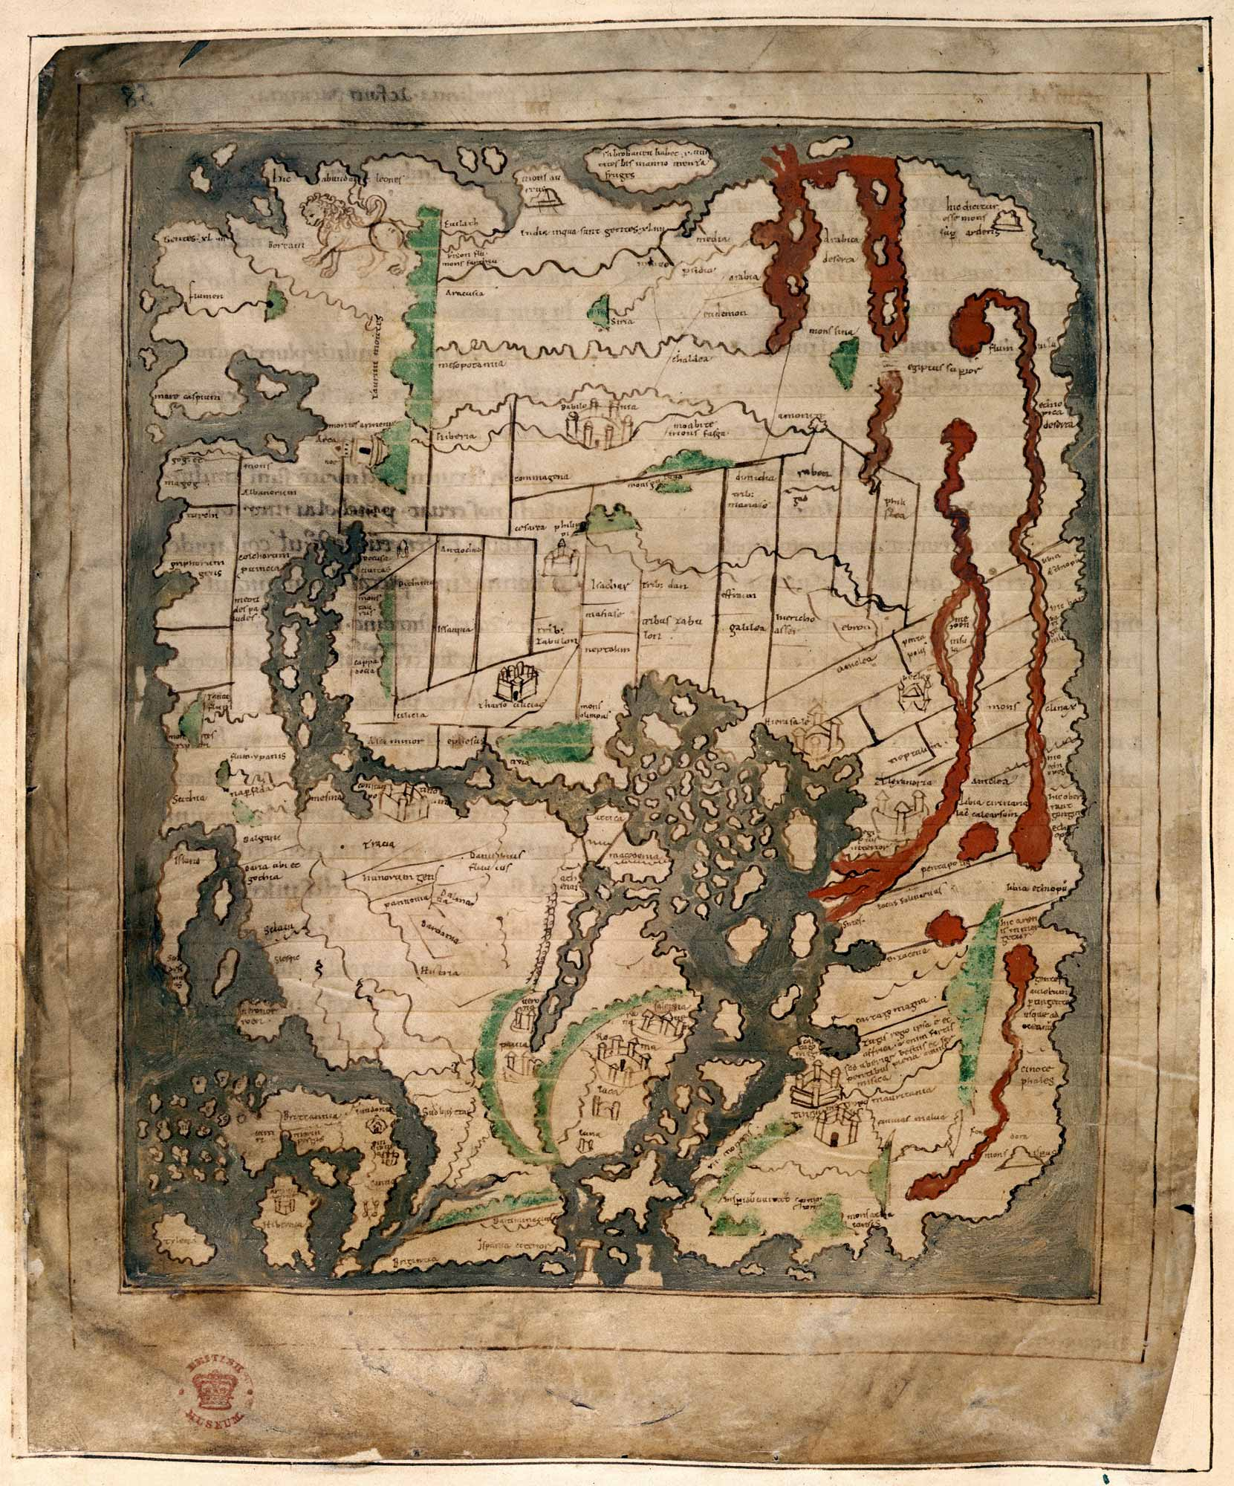
AN EARLY MEDIEVAL VIEW OF THE GLOBE Eleventh-century mappa mundi (‘map of the world’)

Slide 8
AN EARLY MEDIEVAL VIEW OF THE GLOBE Eleventh-century mappa mundi (‘map of the world’)

Slide 9
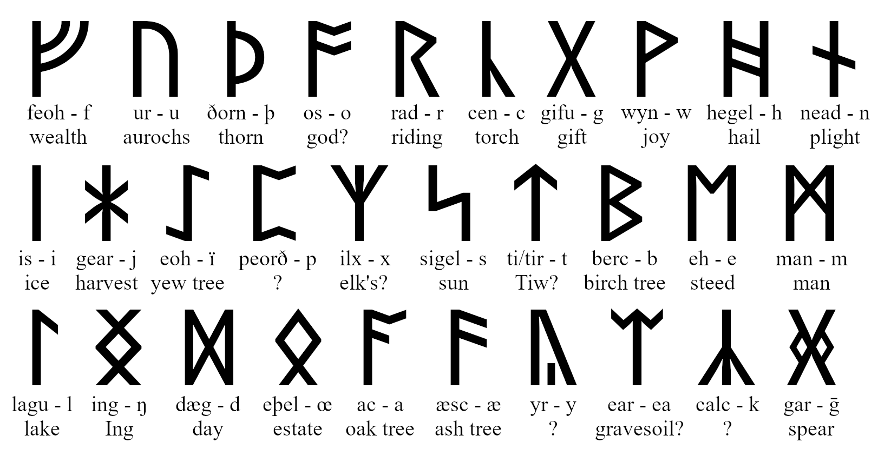
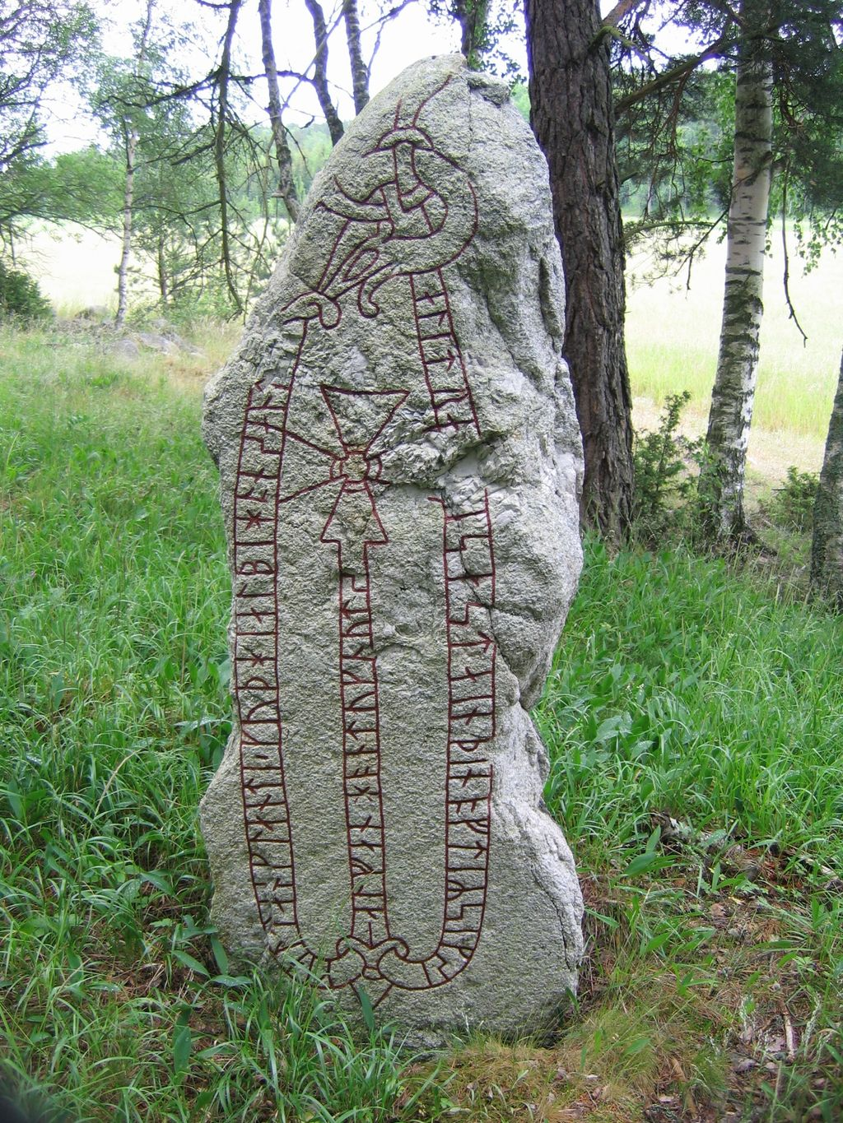
GERMANIC LITERATURE: RUNES
Runes are not magic – they’re a writing system
They each correspond with a sound
They each also have a name, which they can represent as a word

Slide 10
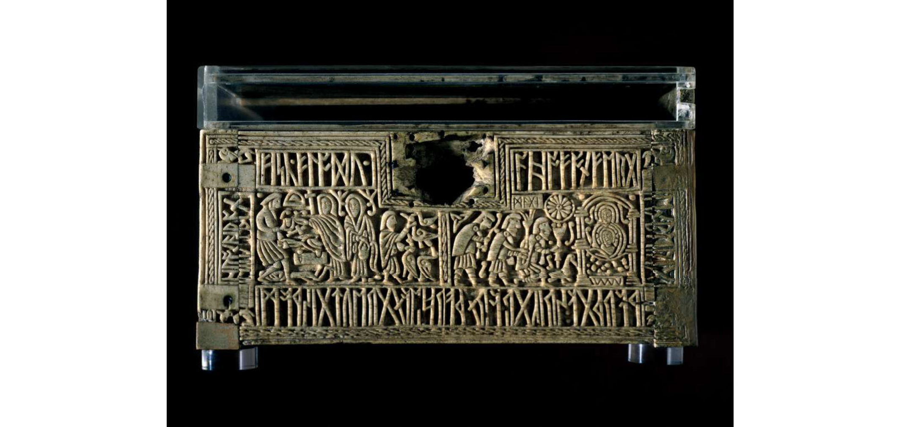
GERMANIC STORIES:WELAND
Weland is a famous smith of Germanic legend whose story survives in a number of witnesses, namely the Old Norse Völundarkviða and Þiðreks saga

Slide 11
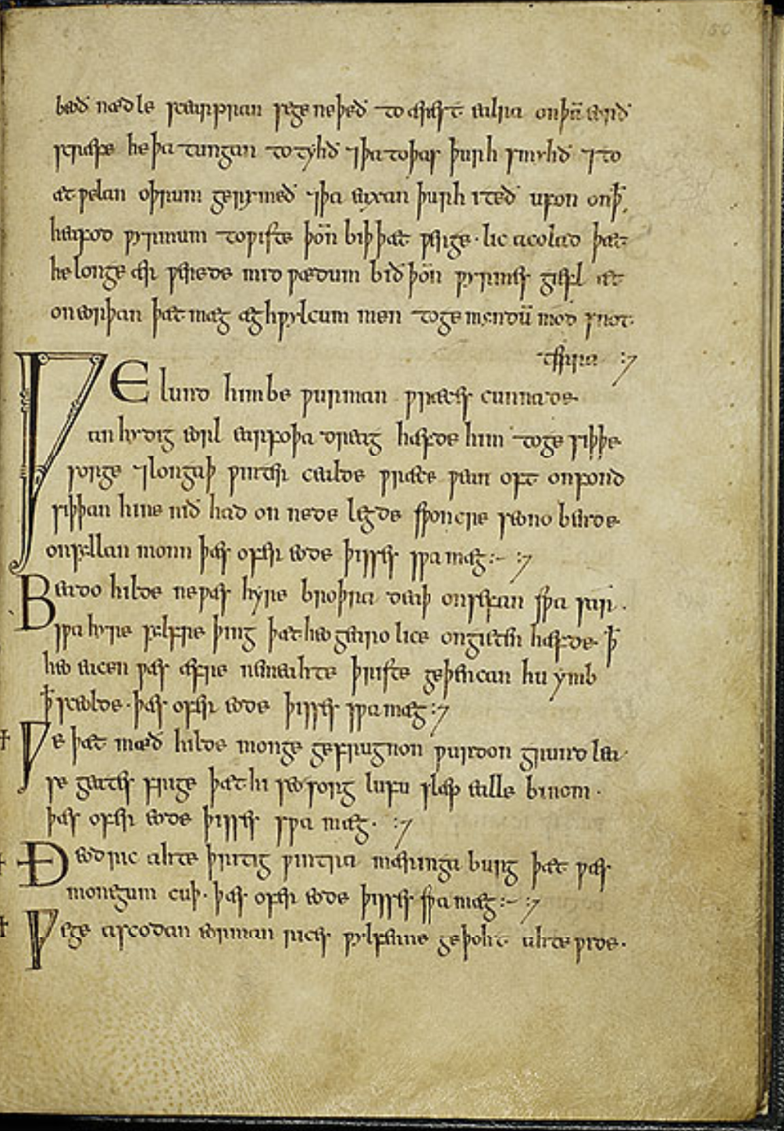
GERMANIC STORIES: WELAND
The Exeter Book is a tenth-century manuscript containing thousands of lines of Old English poetry. Many of the poems it contains (like Deor, shown on the right) were composed much earlier than the manuscript.

Slide 12
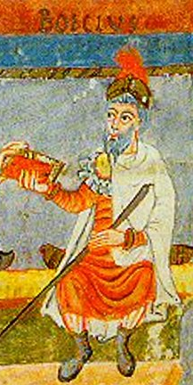
GERMANIC STORIES: WELAND
Anicius Manlius Severinus Boethius
c. 475 – c. 524 CE
Roman statesman who fell from favour, was placed under house arrest and eventually executed
Wrote The Consolation of Philosophy (De consolatione philosophiae), one of the foundational works of western theology, and popular throughout the medieval period
The Consolation considers issues like fate, free will, the transience of human life, and justice

Slide 13
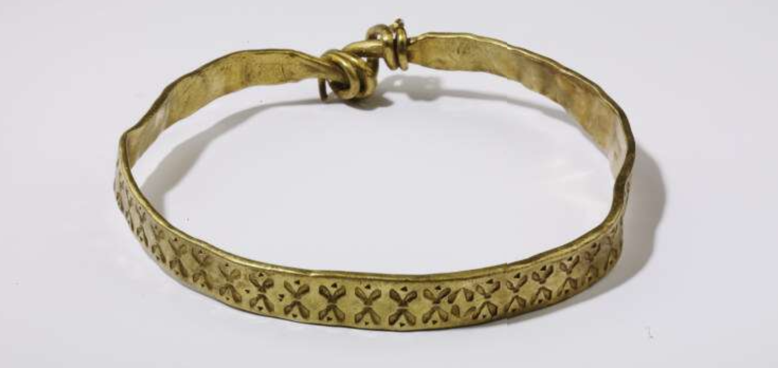
KINGS AND RINGS
Compound diction: epithets for a king
beah-gifa = “ring-giver”
gold-wine = “gold friend”
https://www.britishmuseum.org/collection/object/H_2009-8023-2

Slide 14
THE CHRISTIAN CONVERSION
Extract from M’ óenurán im aireclán
All alone in my little cell, without a single human being along with me: such a pilgrimage would be dear to my heart before going to meet death.
A hidden secluded little hut for forgiveness of all evil; a conscience unperverted and untroubled directed towards holy Heaven. […]
I should love to have Christ son of God visiting me, my Creator, my King, and that my mind should resort to Him in the kingdom in which He dwells.
Let the place which shelters me amid monastic enclosures be a delightful hermit’s plot hallowed by religious stones, with me alone therein.

Slide 15
THE RUTHWELL CROSS
https://sketchfab.com/3d-models/ruthwell-cross-4227085477004f04aadb6b3082b41eb2

Slide 16
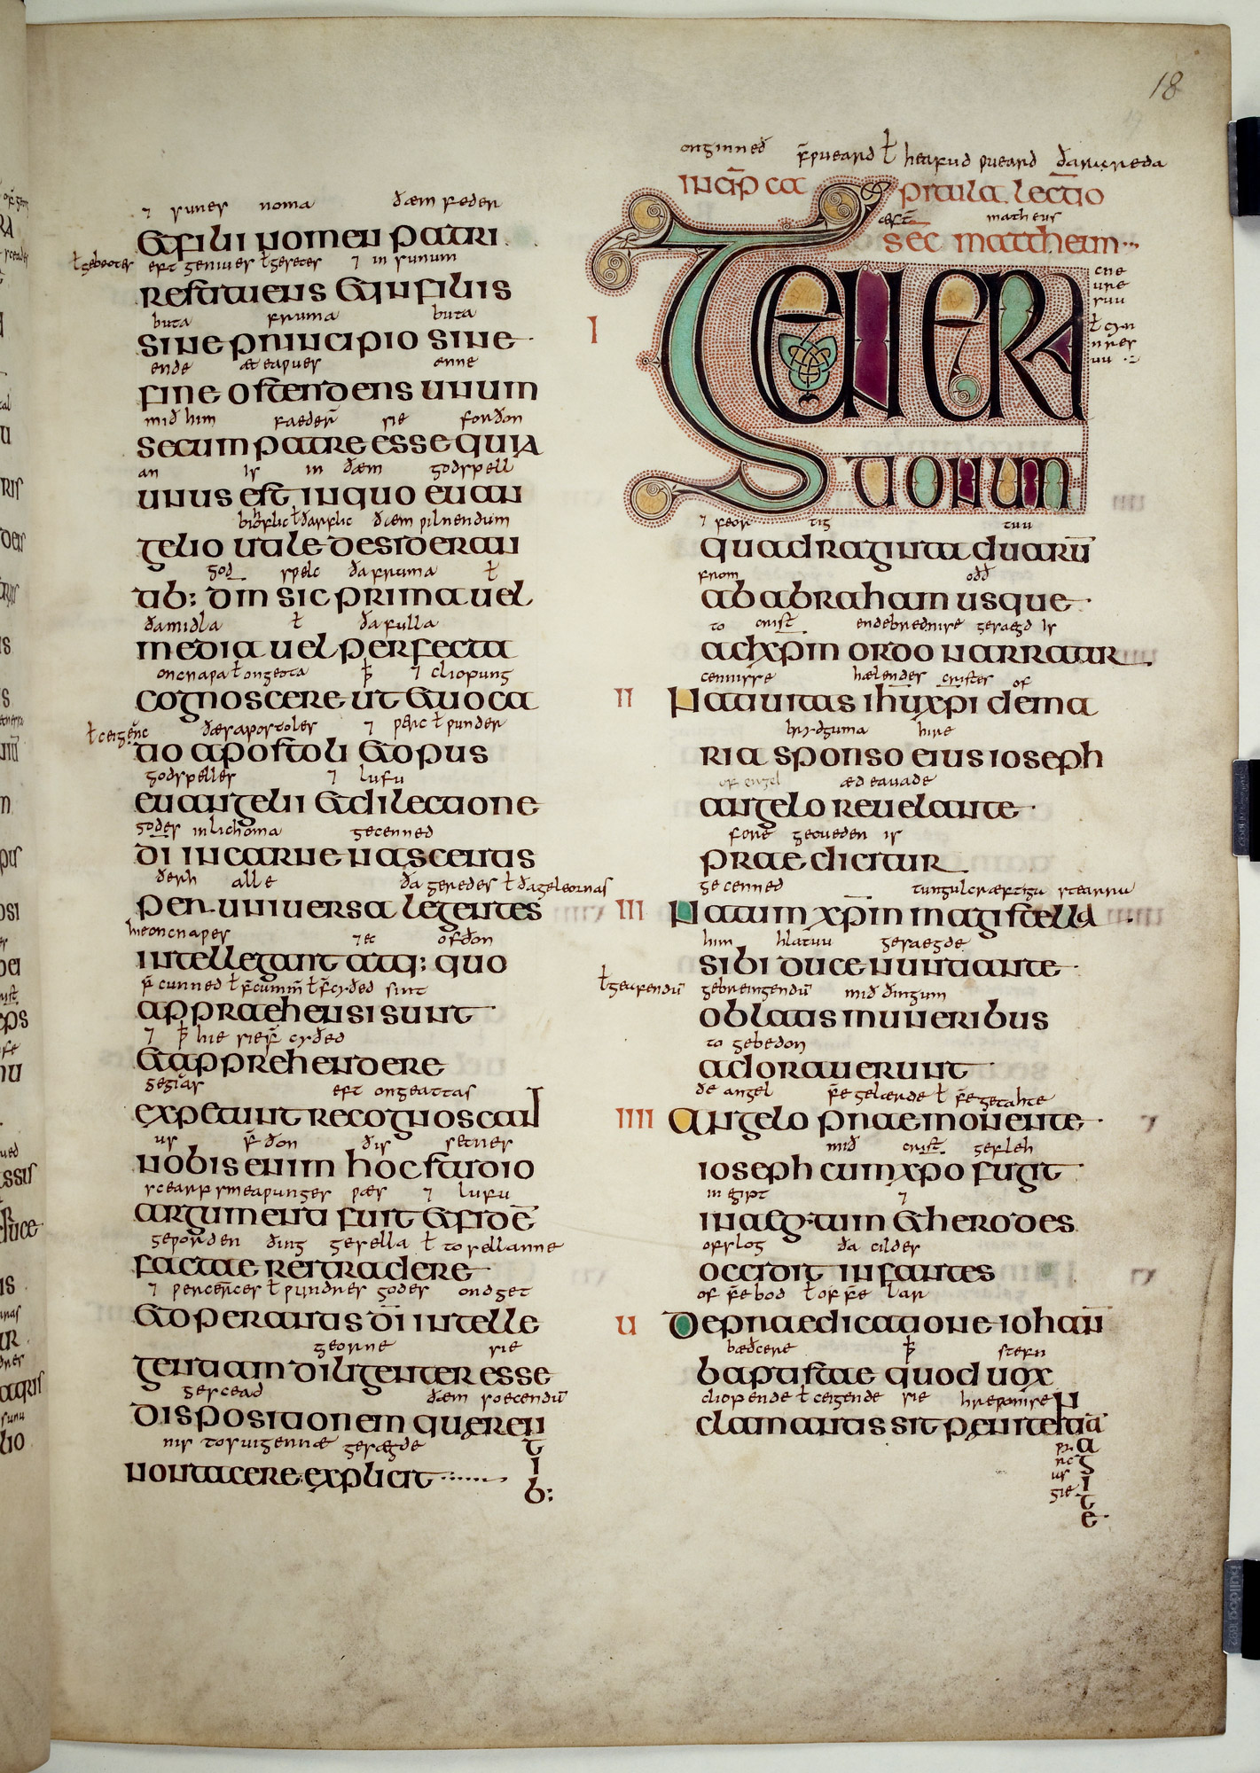
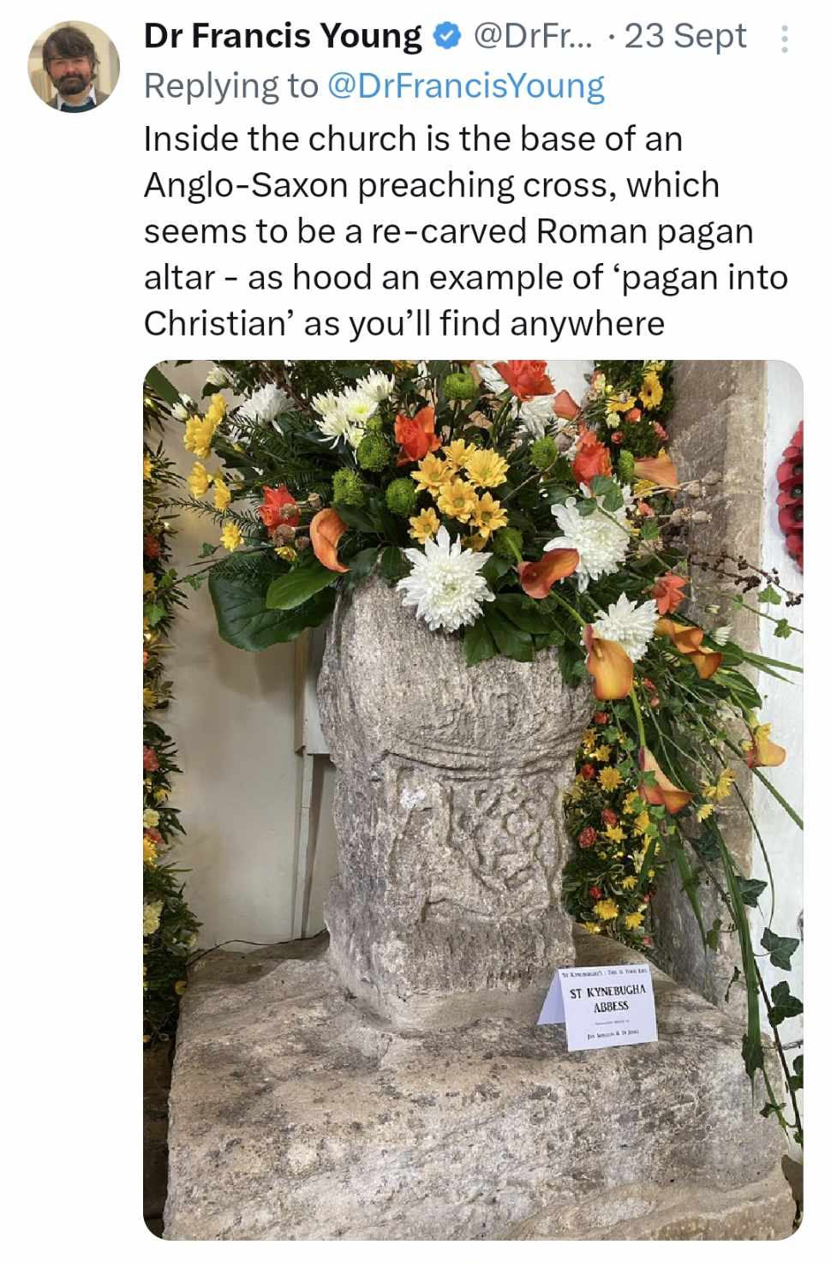
THE CHRISTIAN CONVERSION
“Augustine sent to Æthelberht to say that he had come from Rome bearing the best of news, namely the sure and certain promise of eternal joys in heaven and an endless kingdom with the living and true God to those who received it” - Bede, Historia Ecclesiastica, 39

Slide 17
CHRISTIANISATION: GERMANIC STORIES

Slide 18
CHRISTIANISATION: GERMANIC STORIES
Beowulf: a good Christian king?
him of hwæðre gewat
sawol secean soðfæstre dom
(Beowulf, ll. 2819b-20)
[yet from him his soul departed to seek the judgement of the firm-in-truth]
We get in fact a poem from a pregnant moment of poise, looking back into the pit, by a man learned in old tales who was struggling, as it were, to get a general view of them all, perceiving their common tragedy of inevitable ruin, and yet feeling this more poetically because he was himself removed from the direct pressure of its despair. He could view from without, but still feel immediately and from within, the old dogma: despair of the event, combined with faith in the value of doomed resistance. He was still dealing with the great temporal tragedy, and not yet writing an allegorical homily in verse.
(J.R.R. Tolkein, The Monsters and the Critics)

Slide 19
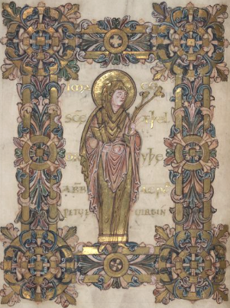
POWERFUL WOMEN: ABBESSES
Hild (614–680) was the abbess of Whitby
Caedmon was an illiterate cowherd living at the monastery in Whitby
He is credited with creating the first Christian poem in Old English, known as Caedmon’s Hymn
He was supported by Hild:
“Then the abbess began to embrace and love the gift of God in that man, and she exhorted and adviced him that he should abandon the worldly life and accept monkhood, and he readily agreed to this. And she accepted him into the monastery, with his goods, and united him into the community of God's servants, and ordered that he be taught the (entire) series of holy stories and narratives.”

Slide 20
A FEW SELECT REFERENCES
See your handouts for more sources and recommended reading.
Blair, John. An Introduction to Anglo-Saxon England, 3rd edition (2003)
Higham, Nicholas J. and Martin J. Ryan, The Anglo-Saxon World (2013)
Horner, Shari. The Discourse of Enclosure Representing Women in Old English Literature (2001)
Irvine, Susan. ‘Religious Context: Pre-Benedictine Reform Period’ , in A Companion to Anglo-Saxon Literature, ed. Philip Pulsiano and Elaine Treharne (2001) pp. 135–50
Lapidge, Michael, ed. The Wiley Blackwel Encyclopedia of Anglo-Saxon England (2014)
Lendinara, Patrizia. ‘The Germanic Background’, in A Companion to Anglo-Saxon Literature, ed. Philip Pulsiano and Elaine Treharne (2001) pp. 121–34
Swanton, Michael, ed. The Dream of the Rood (1996)

